Slide 1


Evaluation of various Classification Techniques for credit card fraud detection
KALASALINGAM ACADEMY OF RESEARCH AND EDUCATION
Final Review
TeAM Members :
1. KALIVELAPALLI PAVAN – 9920004767
2. MOPURI SUSMITHA – 9920004766
3. ASAPU SAIKUMAR – 9920004812
4. YANNAM BHARGAVI – 992004740
GUIDED BY :
Mr.r raja Subramanian
Department of computer science and Engineering
Kalasalingam academy of research and
education

Slide 2
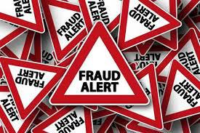
Table of contents
Abstract
Introduction
Literature survey
What will be going to do..?
Dataset
Machine language
Machine learning algorithms used
System requirements
Results
Project demo
conclusion

Slide 3
abstract
Financial fraud is developing threat with many consequences in the finance industries , corporate companies and government organizations.
From many criminal activities occurring in the financial industry , credit card fraudulent activities are the most prevalent .
It is important for the credit card companies to be able to detect the fraud
transactions so that the customers won’t get charged for the items they did not
purchase.

Slide 4
Introduction
The credit card fraud detection becomes challenging for the below ranges :
The profiles of the genuine users and fraudulent behaviours change constantly .
Rate of online transactions have grown exponentially.
The credit card fraud data sets are highly skewed.
Detecting fraudulent transactions using traditional method of manual detection is time
Consuming and inefficient .
Hence , it is necessary to develop a credit card fraud detection technique as a counter measure to fight illegal activities.

Slide 5



Literature survey
Multiple supervised and semi-supervised machine learning techniques are used for fraud detection.
But we are aim to overcome i.e., strong class imbalance , the inclusion of labelled and unlabelled samples and to show the best accuracy in machine learning algorithms .
Different supervised machine learning algorithms like Decision trees, Naïve Bayes classification, Least Squares Regression, Logistic Regression and SVM are used to detect fraudulent transactions in real-time datasets.
Through Supervised learning methods can be used there may fail at
certain cases of detecting the fraud cases.

Slide 6

What will be going to do…?
In this term project , we will try to analyze that 284k transactions with different attributes .
LITINERARY :
Analyze the correlation between attributes.
Analyze the effect of attribute values on target.
All implementation we are going with Python.
Balancing / sampling the skewed dataset.
Application of the machine learning algorithms.
Comparing the results for the algorithms, And showing good accuracy.

Slide 7

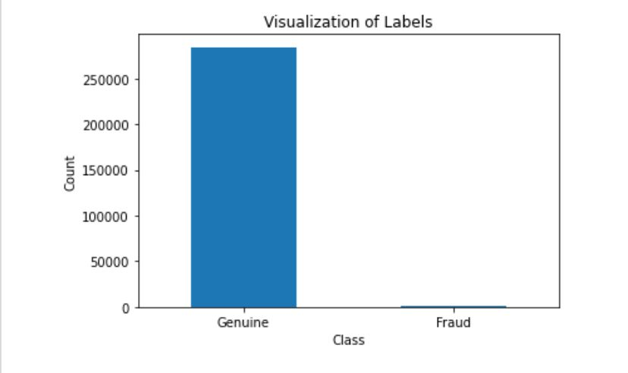
Dataset
The original dataset has 284807 entries and
31 attributes.
The class attribute identifies transaction as Fraud [1]
or Genuine [0].
In Fig.a we can observe that visualization of labels.
The distributes of data is as highly imbalanced.
we are giving randomly for the training and testing for Fig.a
for the data.

Slide 8

Machine language
We are working on PYTHON
LIBRARIES
Pandas
Numpy
Matplotlib
Sklearn

Slide 9
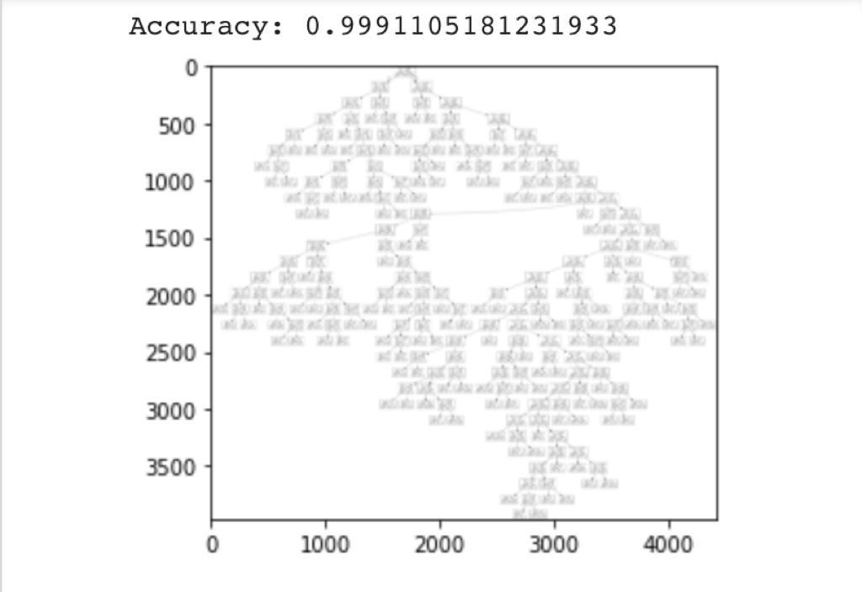
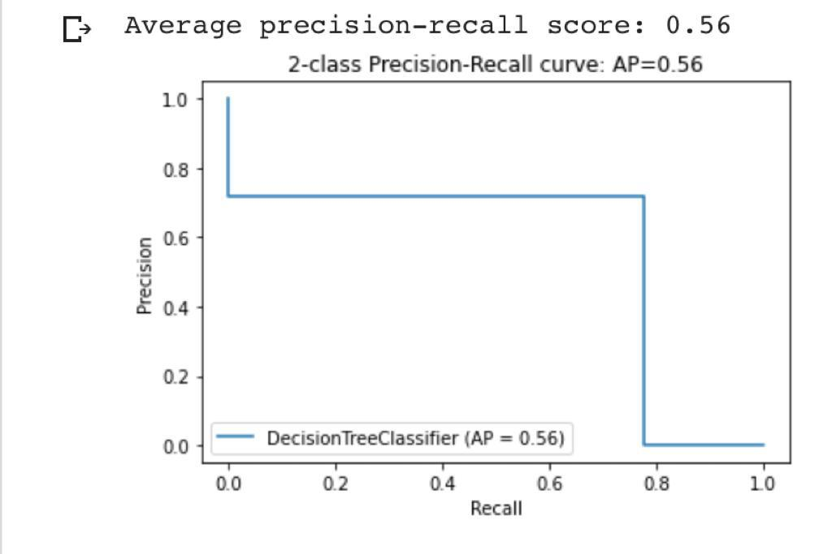
MACHINE LEARNING ALGORITHMS
1.DECISION TREE
A Tree diagram which is used for making the branches or
computer programming and in which the branches represent Fig.1
choices with associated risks, costs, results, or probabilities.
In this algorithm we can get the values
In Fig.1 Decision tree shows Accuracy - 99.91
In Fig.2 shows Average precision-Recall score - 0.56
Area under curve (AUC) - 0.89
Fig.2

Slide 10
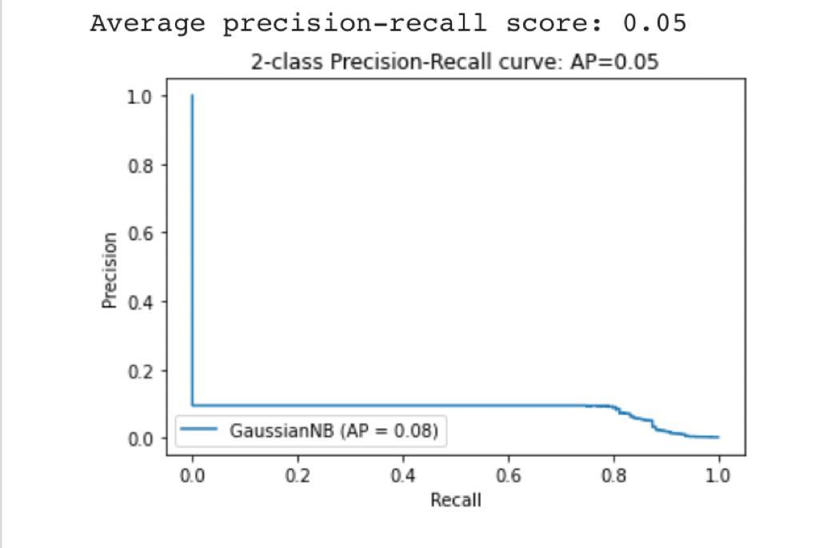
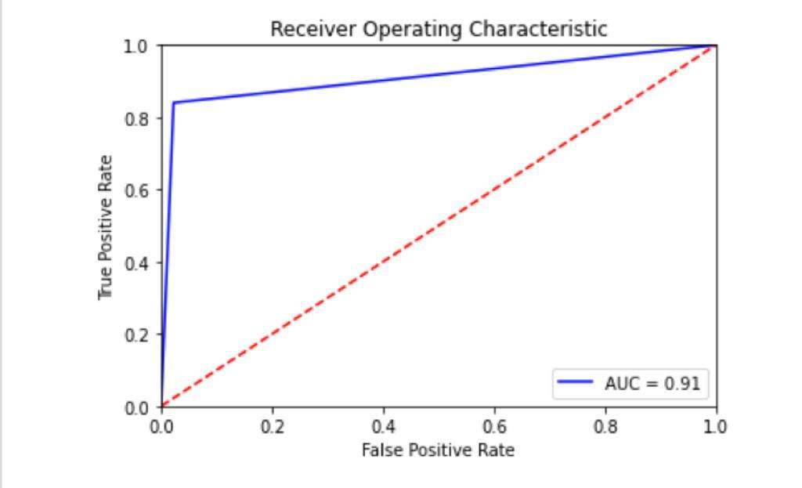
2. GAUSSIAN CLASSIFIER (NAÏVE BAYES)
Naïve Bayes is one of the fast and easy ML algorithms to
Predict a class of datasets.It is the most popular choice
For text classification problems. Fig.3
In this algorithm we can get the values
Accuracy - 97.74
In Fig.3 shows Average precision-Recall score - 0.50
In Fig.4 shows Area under curve (AUC) - 0.91
Fig.4

Slide 11
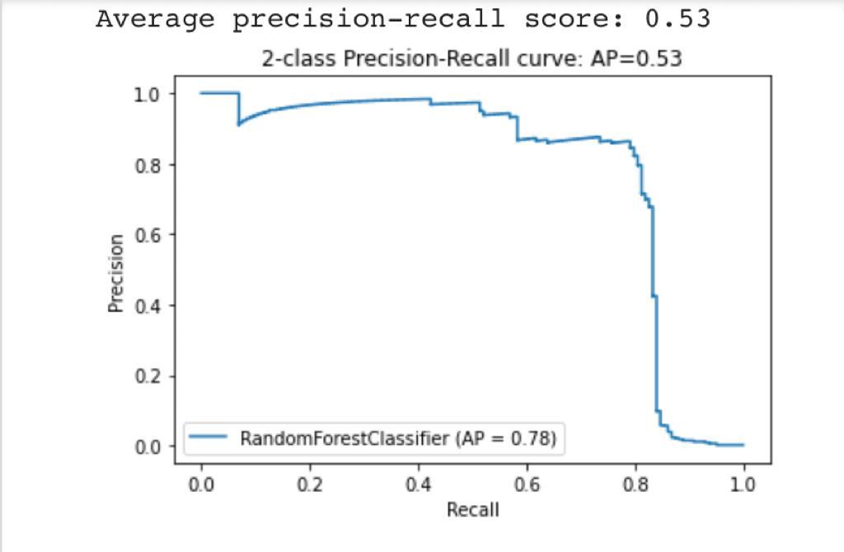
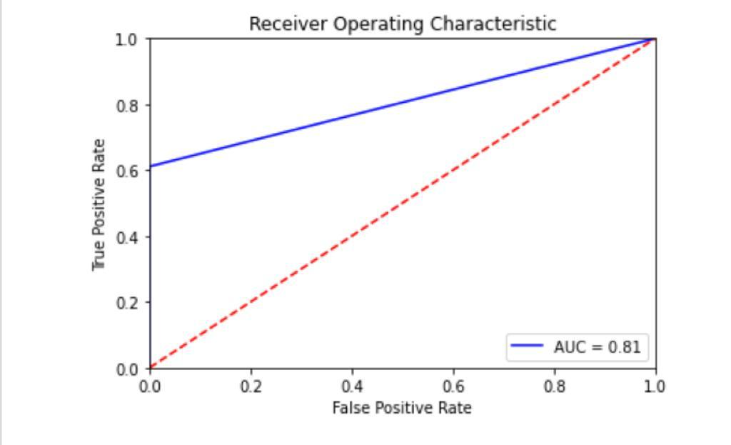
3. RANDOM FOREST CLASSIFIER
Random forest is easy to use machine learning algorithm that
Produces, even without hyper-parameter tuning, a great
Results most of the time.It can be used for both classification Fig.5
And regression .
In this algorithm we can get the values
Accuracy - 99.92
In Fig.5 we can observe Average precision-Recall score shows - 0.53
In Fig.6 shows Area under curve (AUC) - 0.81 Fig.6

Slide 12
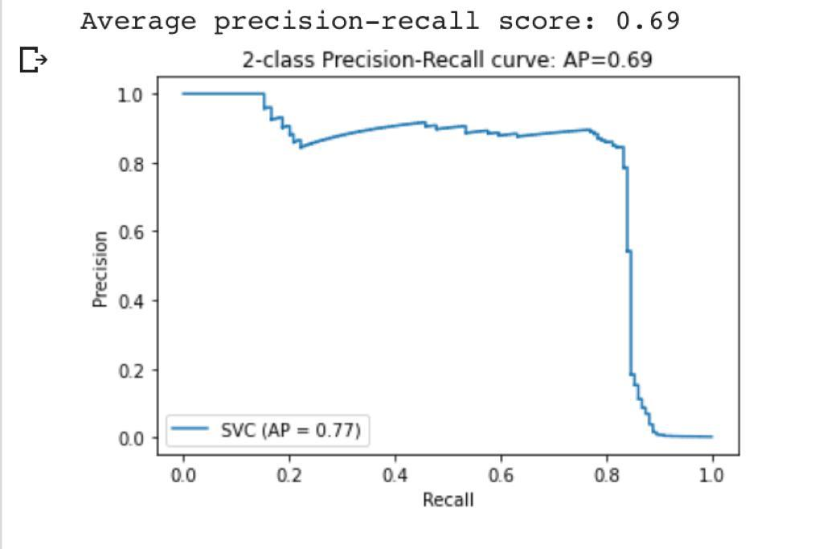
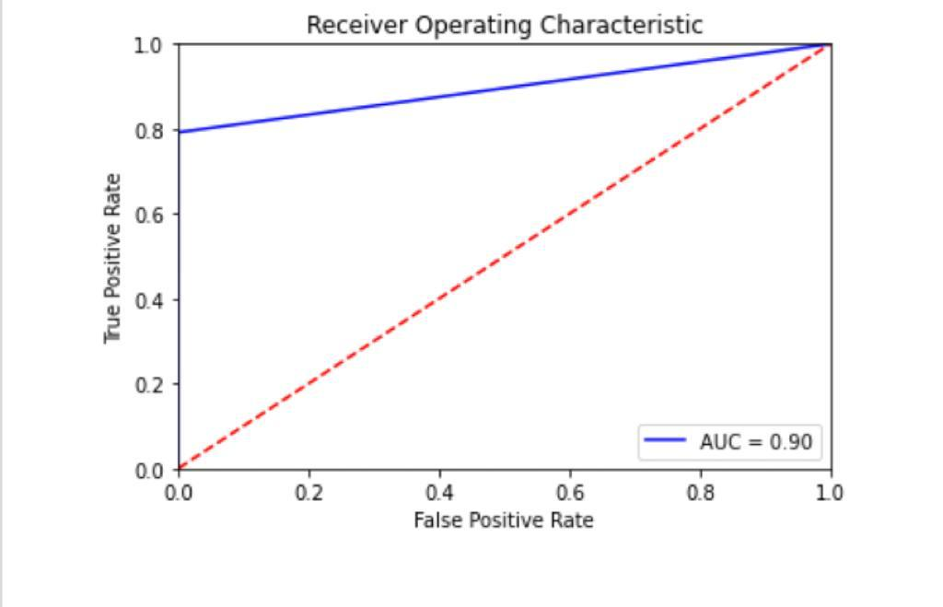
4. LINEAR KERNEL SVM CLASSIFIER
Linear kernel SVM is used when the data is linearly seperable. It is one
Of the most common kernels to be used . It is mostly used when
There are a large number of features in a particular dataset. Fig.7
In this algorithm we can get the values.
Accuracy - 99.90
In Fig.7 shows the Average precision-Recall score - 0.69
In Fig.8 shows Area under curve (AUC) - 0.90
Fig.8

Slide 13

System requirements
HARDWARE REQUIREMENTS :
RAM – 4gb And Higher
Processor – Intel i3 and more
Hard disk – 500GB Minimum
SOFTWARE REQUIREMENTS :
OS – Windows , linux or macOS
Language – Python

Slide 14

RESULTS
CLASSIFIERS | ACCURACY | AVERAGE PRECISION- RECALL SCORE | AREA UNDER CUREVE (AUC)
Decision tree | 99.91 | 0.56 | 0.89
Gaussian classifier (Naïve Bayes) | 97.74 | 0.50 | 0.91
Random forest | 99.92 | 0.53 | 0.81
Linear kernel SVM classifier | 99.90 | 0.69 | 0.90

Slide 15

PROJECT DEMO
We will demo a notebook created on google colab with all minute details
implemented in the project.
Let’s GO ….! For the project implementation.

Slide 16
conclusion
Data imbalance can cause bias in the prediction.
Random forest and Decision tree performs comparatively better.
The best accuracy received from the Random forest 99.92
We are done with stratified validation
Using this machine learning techniques we can detect the credit card frauds

Slide 17
reference
[1] http://www.rbi.org.in/Circular/CreditCard
[2] https://www.ftc.gov/news-events/press-releases/2019/02/imposter-scams-top-complaints-made-ftc-2018 [11] https://www.kaggle.com/mlg-ulb/creditcardfraud
[3] https://www.kaggle.com/uciml/default-of-credit-card-clients-dataset
[4] Jiang, Changjun et al. “Credit Card Fraud Detection: A Novel Approach Using Aggregation Strategy and Feedback Mechanism.” IEEE Internet of Things Journal 5 (2018): 3637-3647.
[5]Pumsirirat, A. and Yan, L. (2018). Credit Card Fraud Detection using Deep Learning based on Auto-Encoder and Restricted Boltzmann Machine. International Journal of Advanced Computer Science and Applications, 9(1).
[6]Mohammed, Emad, and Behrouz Far. “Supervised Machine Learning Algorithms for Credit Card Fraudulent Transaction Detection: A Comparative Study.” IEEE Annals of the History of Computing, IEEE, 1 July 2018, doi.ieeecomputersociety.org/10.1109/IRI.2018.00025.
[7]Randhawa, Kuldeep, et al. “Credit Card Fraud Detection Using AdaBoost and Majority Voting.” IEEE Access, vol. 6, 2018, pp. 14277–14284., doi:10.1109/access.2018.2806420.

Slide 18
Thank you….!

